Slide 1
Comparative Advantage
Chapter 2

Slide 2
Learning Objectives
Explain and apply the Principle of Comparative Advantage
Explain and apply the Principle of Increasing Opportunity Cost (also called the Low-Hanging-Fruit Principle)
Identify factors that shift the menu of production possibilities
Explain and apply the role of comparative advantage in international trade and describe why some jobs are more vulnerable to outsourcing than others

Slide 3
Exchange and Opportunity Cost
Joe Jamail, a highly successful trial attorney, employs another attorney to write his will
Writing your own will: 2 hours
Opportunity cost of 2 hours: $10,000+
Hiring someone to spend 4 hours on your will: $3,200
Making the right economic choice: priceless
Do It Yourself only when
Opportunity cost < hired cost

Slide 4
Exchange and Opportunity Cost
A person has an absolute advantage at a particular task if he or she can perform the task in fewer hours than the other person
A person has a comparative advantage at a particular task if his or her opportunity cost of performing the task is lower than the other person’s opportunity cost

Slide 5
The Principle of Comparative Advantage
The Principle of Comparative Advantage Everyone does best when each person (or each country) concentrates on the activities for which his or her opportunity cost is the lowest.

Slide 6
The Principle of Comparative Advantage
Two parties have different opportunity costs for two activities
Concentrate on the activities for which you have the lowest opportunity cost
Total value of output increases with specialization and trade

Slide 7
Comparative Advantage Example
Production Times | Web Update | Bike Repair
Mary | 20 minutes | 10 minutes
Paula | 30 minutes | 30 minutes
Paula and Mary can each update web pages and repair bikes
Mary has an absolute advantage in both
Comparative advantage drives specialization

Slide 8
Comparative Advantage Example
Production Times | Web Update | Bike Repair
Mary | 20 minutes | 10 minutes
Paula | 30 minutes | 30 minutes
Opportunity Cost | Web Update | Bike Repair
Mary | 2 repairs | 0.5 update
Paula | 1 repair | 1 update

Slide 9
Comparative Advantage Example
Production Times | Web Update | Bike Repair
Mary | 20 minutes | 10 minutes
Paula | 30 minutes | 30 minutes
Hourly Output | Web Update | Bike Repair
Mary | 3 updates | 6 repairs
Paula | 2 updates | 2 repairs

Slide 10
Comparative Advantage Example
Hourly Output | Web Update | Bike Repair
Mary | 3 updates | 6 repairs
Paula | 2 updates | 2 repairs
16 web updates are ordered
Mary spends half her time at each activity: 12 updates and 24 repairs
Paula produces 4 updates and 12 repairs
Total output 16 updates and 36 repairs
Specialization produces 16 updates and 48 repairs
12 more repairs for the same inputs!

Slide 11
Another Example
Hourly Output | Web Update | Bike Repair
Pat | 2 updates | 1 repair
Meg | 3 updates | 3 repairs
This table shows output per hour
Apply the Principle of Comparative Advantage
Look at opportunity cost per unit
Pat repairs bikes and Meg updates web pages
Opportunity Cost | Web Update | Bike Repair
Pat | ½ repair | 2 updates
Meg | 1 repair | 1 update

Slide 12
Sources of Comparative Advantage
Talent
Natural resources
Cultures or societal norms
Languages
Institutions
Value placed on craftsmanship
Support for entrepreneurship

Slide 13
Production Possibilities Curve
A production possibilities curve illustrates the combinations of two goods that can be produced with given resources
Definitions:
Unattainable point
Attainable point
Inefficient point
Efficient point
Scarcity Principle
Give up one good to get another
24
A
Unattainable Combination
16
B
Inefficient Combination
Coffee (lb/day)
8
C
D
4
8
12
Nuts (lb/day)

Slide 14
Comparative Advantage and Production Possibilities
The Production Possibilities Curve
Efficient Point
Any combination of goods for which currently available resources do not allow an increase in the production of one good without a reduction in the production of the other

Slide 15
Comparative Advantage and Production Possibilities
The Production Possibilities Curve
Inefficient Point
Any combination of goods for which currently available resources enable an increase in the production of one good without a reduction in the production of the other

Slide 16
Susan's Production Possibilities
Two goods: coffee and nuts
Work 6 hours per day
1 hour of labor
= 4 pounds of coffee OR
= 2 pounds of nuts
Graph shows options
Negative slope
24
A
Coffee (lb/day)
B
16
8
C
D
4
8
12
Nuts (lb/day)

Slide 17
Susan's Opportunity Cost
Marginal cost: – 8 coffee
Marginal benefit: 4 nuts
Loss in coffee
Gain in nuts
Opportunity cost of 1 nut is 2 coffee
Marginal cost: – 8 nut
Marginal benefit: 16 coffee
Loss in nuts
Gain in coffee
Opportunity cost of 1 coffee is ½ nut
24
A
16
B
Coffee (lb/day)
8
C
D
4
8
12
Nuts (lb/day)

Slide 18
Tom's Production Possibilities
Work 6 hours per day
Productivity determines the slope of the PPC
1 hour of labor
= 4 pounds of nuts OR
= 2 pounds of coffee
Opportunity cost
Marginal cost: – 4 coffee
Marginal benefit: 8 nuts
Tom's opportunity cost of 1 coffee is 2 nuts
His opportunity cost of 1 nut is ½ coffee
A
12
B
8
Coffee (lb/day)
C
4
D
8
16
24
Nuts (lb/day)

Slide 19
Tom, Meet Susan
PPCs show comparative advantage
Sue's curve is steeper, better for coffee
Tom's curve is flatter, better for nuts
Comparative advantage is a comparison
To get 1 coffee
Sue gives up ½ nuts
Tom gives up 2 nuts
24
Susan’s PPC
Coffee (lb/day)
12
Tom’s PPC
12
24
Nuts (lb/day)

Slide 20
Gains from Specialization and Trade
Without trade, each person can consume along his production possibilities curve
What you produce determines what you consume
With trade, each person's consumption can be greater than production
Produce according to comparative advantage
Trade to get what you want

Slide 21
Gains from Specialization and Trade
Preferred diet is half nuts, half coffee
No trade: 8 pounds of coffee and 8 pounds of nuts
Total output is 32 pounds
Specialization gives each person 12 pounds of each good
48 total pounds
24
Susan and Tom exchange 12 nuts, 12 coffee
Coffee (lb/day)
12
8
8
12
24
Nuts (lb/day)

Slide 22
Gains from Specialization and Trade
Benefits increase when differences in opportunity cost increase
Sue's opportunity cost of one pound of nuts increases to 6 coffee
Tom's opportunity cost of one pound of coffee increases to 6 nuts
No trade: 3.4 nuts and 3.4 coffee each
With trade: 12 nuts and 12 coffee each
Sue's PPC
24
Trade benefits
12
With trade
Coffee (lb/day)
4
Tom's PPC
4
12
24
No trade
Nuts (lb/day)

Slide 23
Production Possibilities for a National Economy
Two goods: coffee and nuts
Multiple people
Different opportunity costs
Intercepts show maximum production of one good
Some resources better at coffee, some better at nuts
100
A
B
95
C
90
Coffee (1000s of lb/day)
20
D
15
E
20
30
75
80
77
Nuts (1000s of lb/day)

Slide 24
The Principle of Increasing Opportunity Cost
Maximum coffee: 100,000 lb / day
Give up 5,000 pounds coffee, get 20,000 pounds of nuts
Give up another 5,000 pounds of coffee, get 10,000 additional pounds of nuts
100
A
B
95
C
90
Coffee (1000s of lb/day)
20
D
15
E
20
30
75
80
77
Nuts (1000s of lb/day)

Slide 25
Production Possibilities Curve For a Large Economy
Coffee
(1000s of lb/day)
Assume: An economy that produces only two goods, coffee and nuts
100
A
B
C
Why would the Production Possibilities Curve have an outward bow?
95
90
D
20
15
E
Nuts
(1000s of lb/day)
20
30
75
80
77

Slide 26
Comparative Advantage and Production Possibilities
The Principle of Increasing Opportunity Cost (“The Low-Hanging-Fruit Principle”)
In expanding the production of any good, first employ those resources with the lowest opportunity costs, and only afterward turn to resources with higher opportunity costs

Slide 27
Economic Growth: An Outward Shift in the Economy’s PPC
Factors Shifting the PPC
1. Increases in productive resources
(i.e., labor or capital)
2. Improvements in knowledge and technology
Coffee
(1000s of lb/day)
New PPC
Original PPC
Nuts
(1000s of lb/day)

Slide 28
Factors That Shift The Economy’s Production Possibilities Curve
Increasing Productive Resources
Investment in new factories and equipment
Population growth
Improvements in Knowledge and Technology
Increasing education
Gains from specialization

Slide 29
Factors That Shift The Economy’s Production Possibilities Curve
Why have countries Like Nepal been so slow to specialize?
Low population density
Isolation
Some factors that may limit specialization in other countries
Laws
Customs

Slide 30
The Principle of Increasing Opportunity Cost
Start with resources with lowest opportunity cost
Then move to next highest opportunity cost
And still higher opportunity cost
Decreasing productivity
Resources Used

Slide 31
The Dynamic Economy
A PPC represents current choices
Changes in choices occur over time due to
More resources
Investment in capital
Population growth
Improvements in technology
More specialization: start-up and switching costs
Increases in knowledge

Slide 32
Shifts in PPC
Technical Change in Coffee
Neutral Technical Change
Coffee
Coffee
Nuts
Technical Change in Nuts
Nuts
Coffee
Nuts

Slide 33
Some Countries Resist Specialization
Specialization is easier when
Population density passes a threshold
Markets are connected
Transportation for goods
Communications for services
Legal framework supports business
Financial markets enable start-ups

Slide 34
Specialization: Benefits and Costs
Can we have too much specialization?
What do you think?
What are the costs of specialization?
Economic Naturalist
If trade between nations is so beneficial, why are free-trade agreements so controversial?

Slide 35
Too Much Specialization?
Imagine this:
Your hair stylist only cuts blonde hair
An expert in tropical diseases opens a practice in a town of 500 people in Wisconsin
Seven bookstores, each open a different day of the week

Slide 36
Comparative Advantage and International Trade
Principle of Comparative Advantage and gains from trade apply worldwide
Potentially large gains from trading with different and distant countries
Trade can be controversial
Trade benefits society broadly
Costs are concentrated
Some industries suffer
People lose their jobs

Slide 37
Outsourcing
Service work performed overseas by low wage workers has been termed outsourcing
Medical transcription ▪ Medical tourism
Customer call centers ▪ Technical writing
Limits to outsourcing
Quality control
Physical presence (haircuts)
Complex communications
Understand nuance
Greatest security for workers is the ability to adapt quickly to changing circumstances

Slide 38
Reasons for Trade
Absolute Advantage
When a country has the best technology for producing a good, it has an absolute advantage in the production of that good.
Absolute advantage is not a good explanation for trade patterns.
Comparative Advantage
Instead, comparative advantage is the primary explanation for trade among countries.
A country has comparative advantage in producing those goods that it produces best compared with how well it produces other goods.

Slide 39
Ricardian Model
The Home Country
To develop a Ricardian model of trade, we will use an example with two goods:
Wheat and other grains are major exports of the U.S. and Europe.
Many types of cloth are imported into these countries.
For simplicity, we ignore the role of land and capital and suppose that both goods are produced with labor alone.

Slide 40
Ricardian Model
The Home Country
We assume that labor is the only resource used to produce goods. The marginal product of labor (MPL) is the extra output obtained by using one more unit of labor.
In Home, one worker produces 4 bushels of wheat, so MPL_{W} = 4.
Alternatively, one worker can produce 2 yards of cloth, so MPL_{C} = 2.

Slide 41
Ricardian Model
Home Production Possibilities Frontier
We can graph Home’s production possibilities frontier (PPF) using the marginal products for wheat and cloth.
The slope of the PPF is also the opportunity cost of wheat, the amount of cloth that must be given up to obtain one more unit of wheat.
If Home had 25 workers and all were employed in wheat, Home could produce 100 bushels. If all were employed in cloth they could produce 50 yards.

Slide 42
Ricardian Model
Showing these calculations we can see:
Labor = 25, MPL_{W} = 4, MPL_{C} = 2
Q_{W} = MPL_{W}(L) = 25(4) = 100
Q_{C} = MPL_{C}(L) = 25(2) = 50
This gives us a straight line PPF which is a unique feature of the Ricardian model.
It assumes the marginal products of labor are constant.
There are no diminishing returns because the model ignores the use of other resources.
2-42

Slide 43
Ricardian Model
The slope of the PPF can be calculated as the ratio of marginal products of the two goods.
The slope also equals the opportunity cost of wheat—the amount of cloth that must be given up to obtain one more unit of wheat.
2-43

Slide 44
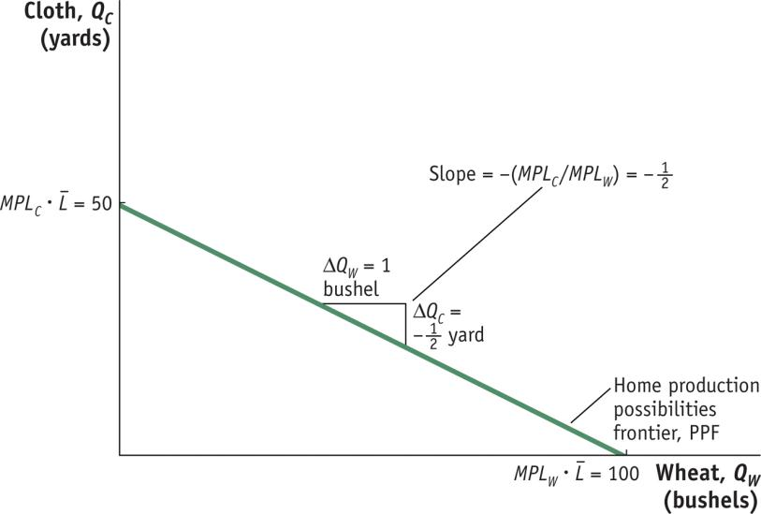
Ricardian Model
Home Production Possibilities Frontier
The Home PPF is a straight line between 50 yards of cloth and 100 bushels of wheat.
The slope of the PPF equals the negative of the opportunity cost of wheat. Equivalently, the magnitude of the slope can be expressed as the ratio of the marginal products of labor for the two goods.

Slide 45
Ricardian Model
Home Indifference Curve
All points on an indifference curve have the same level of utility.
Points on higher indifference curves have higher utility.
Each indifference curve shows the combinations of two goods, such as wheat and cloth, that a person or economy can consume and be equally satisfied.

Slide 46
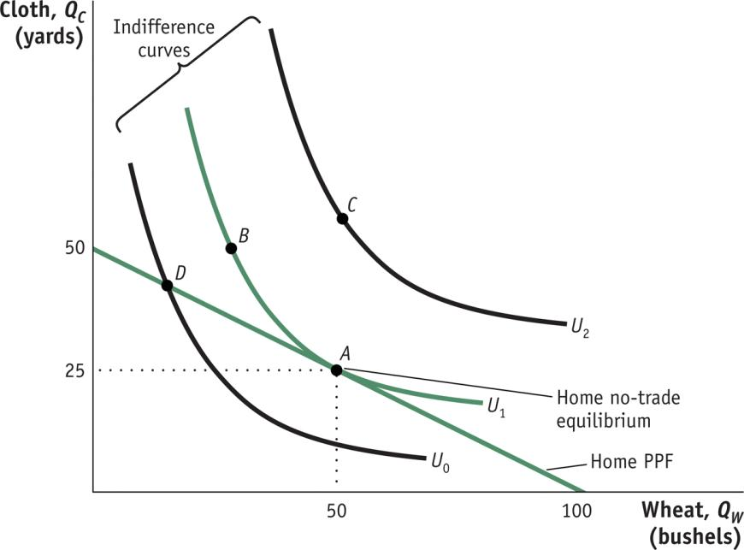
Ricardian Model
FIGURE 2-2
Home Equilibrium with No Trade
Points A and B lie on the same indifference curve and give the Home consumers the level of utility U₁.
The highest level of Home utility on the PPF is obtained at point A, which is the no-trade equilibrium.
Point D is also on the PPF but would give lower utility.
Point C represents a higher utility level but is off of the PPF, so it is not attainable in the absence of international trade.
Notes:
With perfectly competitive markets, the country will produce at its highest level of utility within the limits of the PPF.

Slide 47
Ricardian Model
Opportunity Cost and Prices
The slope of the PPF reflects the opportunity cost of producing one more bushel of wheat.
Under perfect competition the opportunity cost of wheat should also equal the relative price of wheat.
Price reflects the opportunity cost of a good.

Slide 48
Ricardian Model
The price ratio, P_{W}/P_{C}, always denotes the relative price of the good in the numerator, measured in terms of how much of the good in the denominator must be given up.
The slope of the PPF equals the relative price of wheat, the good on the horizontal axis.

Slide 49
Ricardian Model
Wages
In competitive markets firms hire workers up to the point at which the hourly wage equals the value of one more hour of production.
The value of one more hour of labor equals the amount of goods produced in that hour (MPL) times the price of the good.
Labor will be hired up to the point where wage (W) equals W = P • MPL
for each industry.

Slide 50
Ricardian Model
The Foreign Country
Assume a Foreign worker can produce one bushel of wheat or one yard of cloth.
MPL*_{W} = 1, MPL*_{C} = 1
Assume there are 100 workers available in Foreign.
If all workers were employed in wheat they could produce 100 bushels.
If all workers were employed in cloth they could produce 100 yards.

Slide 51
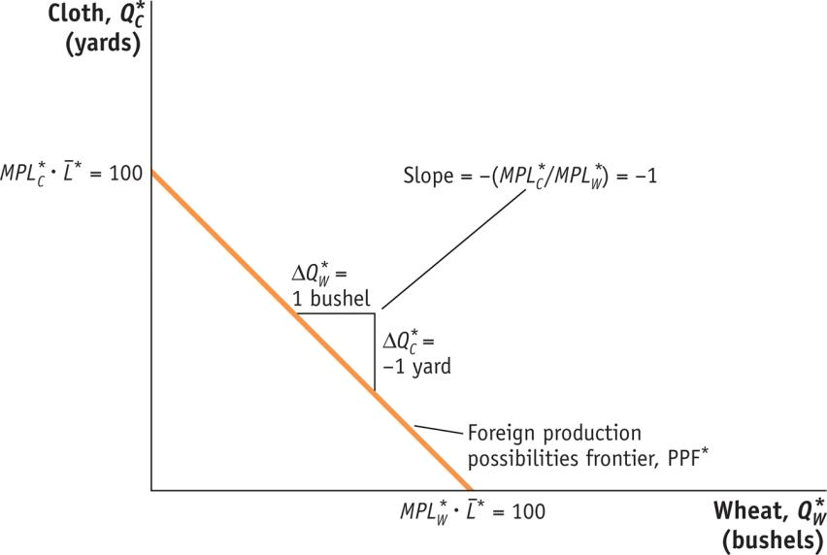
Ricardian Model
Foreign Production Possibilities Frontier
The Foreign PPF is a straight line between 100 yards of cloth and 100 bushels of wheat.
The slope of the PPF equals the negative of the opportunity cost of wheat.
The opportunity cost is the amount of cloth that must be given up (1 yard) to obtain 1 more bushel of wheat.

Slide 52
Ricardian Model
Comparative Advantage
Given the information we have gathered, we can begin to talk about the opportunity cost of production of each good in each country.
Given the opportunity cost information, we can determine comparative advantages in each country for each good.

Slide 53
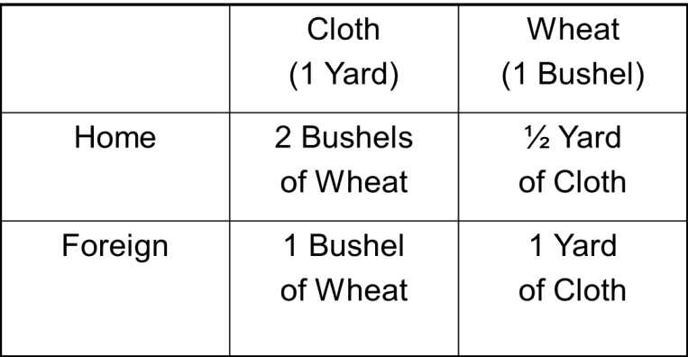
Ricardian Model
Comparative Advantage
A country has a comparative advantage in a good when it has a lower opportunity cost of producing than another country.
By looking at the chart we can see that Foreign has a comparative advantage in producing cloth. Home has a comparative advantage in producing wheat.

Slide 54
The Pattern of International Trade
International Trade Equilibrium
What happens when goods are traded between Home and Foreign? We will see:
that a country’s no-trade relative price determines which product it will export and which it will import.
the no-trade relative price equals its opportunity cost of production.
the pattern of exports and imports will be determined by the opportunity costs of production in each country—their comparative advantage.

Slide 55
Determining the Pattern of International Trade
Examining each country’s no-trade relative price we can determine which product it will export and which it will import.
The relative price of cloth in Foreign is P_{C} /P_{W} = 1.
The relative price of cloth in Home is P_{C} /P_{W} = 2.
Therefore, Foreign would want to export cloth to Home—they can make it for $1 and export it for more than $1.
Home will export wheat and Foreign will export cloth.
Both countries export the good for which they have the comparative advantage.

Slide 56
Determining the Pattern of International Trade
The two countries are in an international trade equilibrium when the relative price of wheat is the same in the two countries.
To fully understand the international trade equilibrium, we are interested in two issues:
Determining the relative price of wheat (or cloth) in the trade equilibrium
Seeing how the shift from the no-trade equilibrium to the trade equilibrium affects production and consumption in both Home and Foreign.

Slide 57
Determining the Pattern of International Trade
The relative price of wheat in the trade equilibrium will be between the no-trade price in the two countries.
For now assume the free-trade price of P_{W} /P_{C} is 2/3 (between the price of ½ in Home and 1 in Foreign).
We can now take this price and see how trade changes production and consumption in each country.
The world price line shows the range of consumption possibilities that a country can achieve by specializing in one good and engaging in international trade.

Slide 58
Determining the Pattern of International Trade
How Trade Occurs?
As Home exports wheat, quantity of wheat sold at Home falls.
The price of wheat at Home is bid up.
More wheat goes into Foreign’s market.
The price of wheat in Foreign falls.
As Foreign exports cloth, the quantity sold in Foreign falls, and the price in Foreign for cloth rises.
The price of cloth at Home falls.

Slide 59
Determining the Pattern of International Trade
International Trade Equilibrium
The relative price of wheat in the trade equilibrium will be between the no-trade price in the two countries.
For now we will assume the free-trade price of P_{W}/P_{C} is 2/3. This is between the price of ½ in Home and 1 in Foreign.
We can now take this price and see how trade changes production and consumption in each country.

Slide 60
Determining the Pattern of International Trade
Change in Production and Consumption
Home producers of wheat can earn more than the opportunity cost of wheat by selling it to Foreign.
Home will therefore shift labor resources toward the production of wheat and increase its production.
Remember wages are calculated by the price of the good times its marginal product.
Given the information from before, we can calculate the ratio of wages in the two industries.

Slide 61
Determining the Pattern of International Trade
Home’s workers will want to work in wheat and no cloth will be produced.
With trade, Home will be fully specialized in wheat production.

Slide 62
Determining the Pattern of International Trade
International Trade
Home can export wheat at the international relative price of 2/3.
For each bushel of wheat it exports, it gets 2/3 yards of cloth in return.
The world price line shows the range of consumption possibilities that a country can achieve by specializing in one good and trading.
Remember: this is only a consumption possibility because production is still constrained by the PPF.

Slide 63
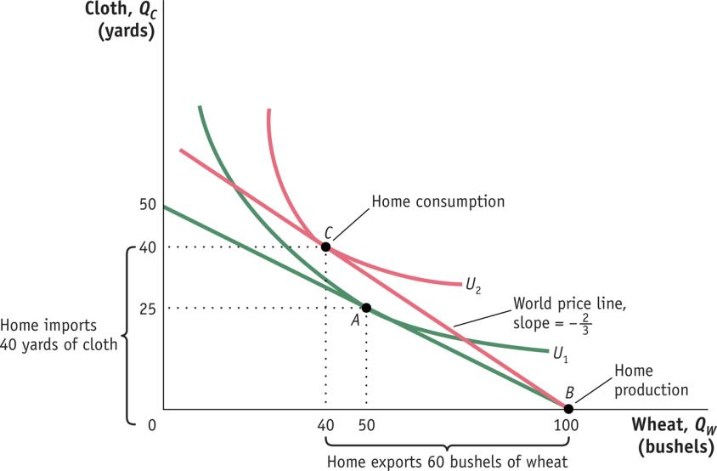
Determining the Pattern of International Trade
Change in Production and Consumption
Home Equilibrium with Trade
We can see that total exports are 60 bushels of wheat in exchange for imports of 40 yards of cloth and also that Home consumes 10 fewer bushels of wheat and 15 more yards of cloth relative to its pre-trade levels. Home’s utility increases with trade is our first demonstration of the gains from trade.

Slide 64
Pattern of Trade and Gains from Trade
Each country is exporting the good for which it has the comparative advantage.
This confirms that the pattern of trade is determined by comparative advantage.
This is the first lesson of the Ricardian model.
There are gains from trade for both countries. This is the second lesson of the Ricardian model.

Slide 65
Determining the Pattern of International Trade
Pattern of Trade and Gains from Trade
However, we have not yet determined the level of wages across countries.
Relative prices converge. Do wages?
Wages do rise in each country, but they do not converge.
They are determined by absolute advantage, not comparative advantage.

Slide 66
Labor Productivity and Wages
Labor productivity can be measured by the value-added per hour in manufacturing.
Value-added is the difference between sales revenue in an industry and the costs of intermediate inputs.
Equals the payments to labor and capital in an industry.
The Ricardian model ignores capital so we can measure labor productivity as value-added divided by the number of hours worked, or value-added per hour.
The Figure A below shows value-added per hour in manufacturing for several countries in 2001, while Figure B in 2010.
Countries with higher labor productivity pay higher wages, just as the Ricardian model predicts.

Slide 67
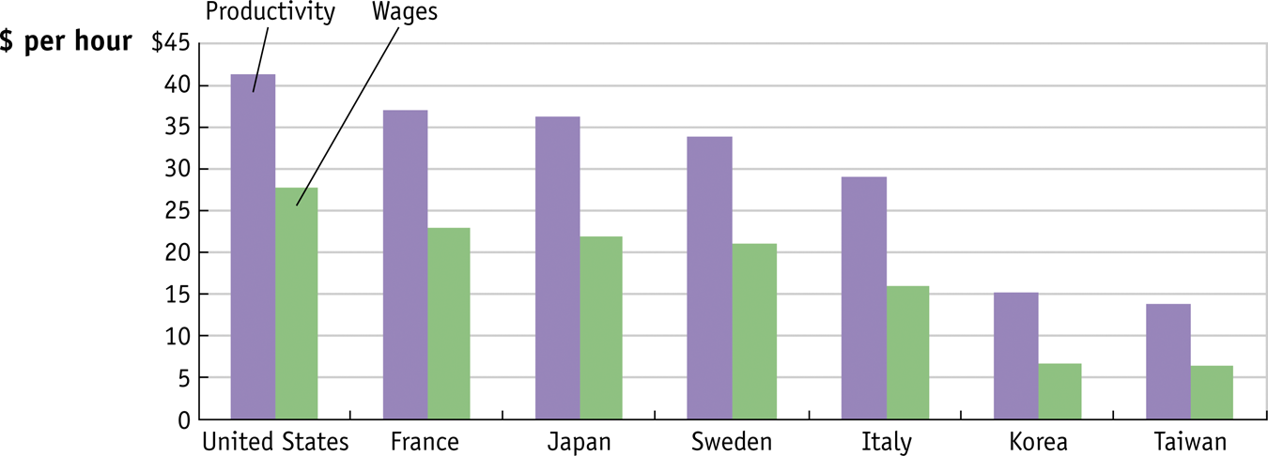
Labor Productivity and Wages
Figure A: Labor Productivity and Wages, 2001
Notes:
Figure 2.7 Labor Productivity and Wages, 2001 Labor productivity is measured by value-added per hour of work and can be compared with the wages paid in manufacturing in various countries. The general ranking of countries—from highest to lowest—in terms of labor productivity is the same as the ranking in terms of wages: countries with higher labor productivity pay higher wages, just as the Ricardian model predicts.
Source: U.S. Department of Labor, Bureau of Labor Statistics

Slide 68
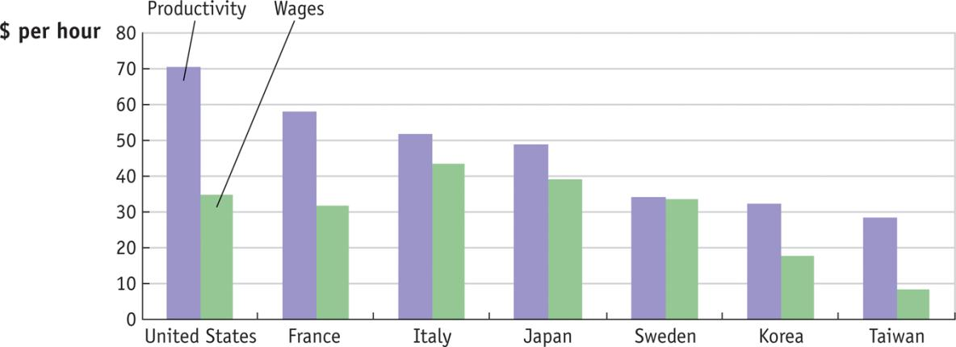
Labor Productivity and Wages, 2010
Labor Productivity and Wages, 2010 Labor productivity is measured by value-added per hour of work and can be compared with the wages paid in manufacturing in various countries.
Notes:
The general ranking of countries—from highest to lowest—in terms of labor productivity is the same as the ranking in terms of wages: countries with higher labor productivity pay higher wages, just as the Ricardian model predicts.

Slide 69
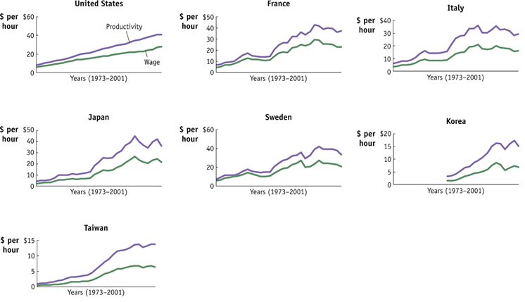
Labor Productivity and Wages
Notes:
Figure 2.8 Labor Productivity and Wages over Time The trends in labor productivity and wages can also be graphed over time. The general upward movement in labor productivity is matched by upward movements in wages, as predicted by the Ricardian model.
Source: U.S. Department of Labor, Bureau of Labor Statistics.

Slide 70
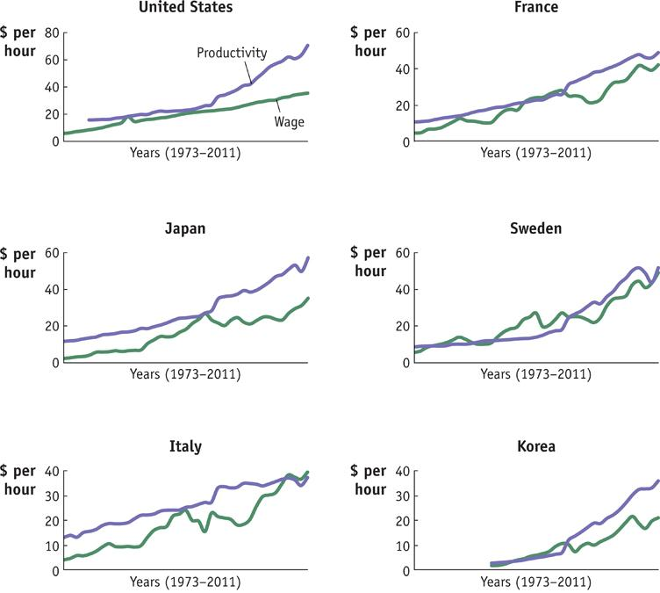
Labor Productivity and Wages
The trends in labor productivity and wages can also be graphed over time.
The general upward movement in labor productivity is matched by upward movements in wages, as predicted by the Ricardian model.

Slide 71
Solving for International Prices
In the previous analysis we assumed the world price of wheat was 2/3.
In reality world price is determined by a market for exports and imports.
We will derive a Home export supply curve.
Shows the amount it wants to export at various relative prices.
Similarly we will derive a Foreign import demand curve.
Shows the amount of wheat that it will import at various relative prices.

Slide 72
Solving for International Prices
Home Export Supply Curve
We can use the information we gathered before to derive an export supply curve.
The export supply curve will have the relative price of wheat on the Y-axis and the amount of wheat on the X-axis.
We saw above a relative price of 2/3 related to exports of 60 bushels.
The first point on the export supply curve: the horizontal distance from point B to C in figure C and point C’ in figure D.

Slide 73
Solving for International Prices
To derive other points on the export supply curve we look at the no-trade equilibrium.
When the relative price of wheat is ½, Home exports of wheat are zero (no-trade equilibrium).
Point A and A’ in figure C
For the 3rd point, we keep the relative price of wheat at ½.
At this price, Home could export some wheat in exchange for cloth.
Production could shift from A to any other place on the PPF.
Workers are willing to shift between industries as the wages are the same.

Slide 74
Solving for International Prices
If we assume that all workers have moved into wheat production.
With the relative price of ½, consumption is still at point A and the difference between A and B is the amount of wheat that Home is exporting.
At the relative price of ½, with wheat exports of 50, gives another point on the Home export supply curve: B’.

Slide 75
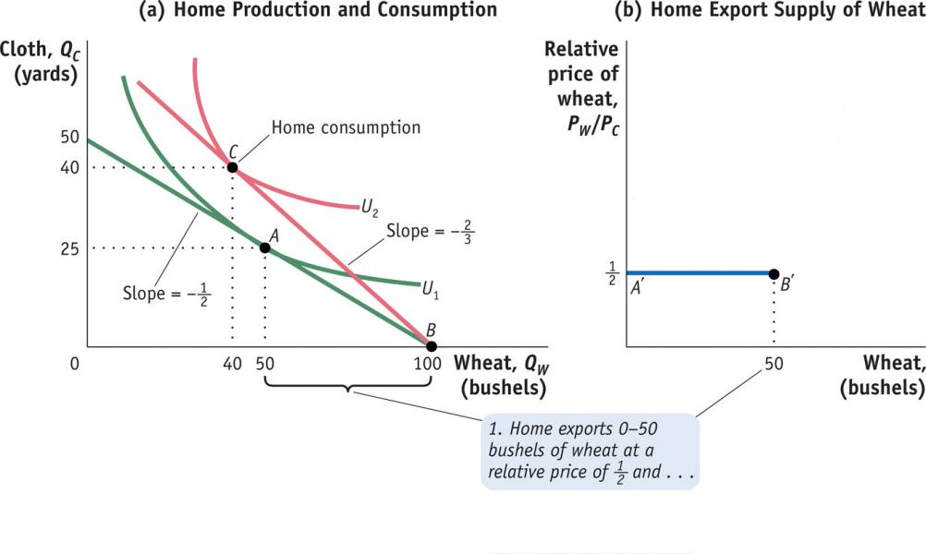
Home Export Supply Curve
Home Export Supply Panel (a) repeats Figure B showing the trade equilibrium for Home with production at point B and consumption at point C. Panel (b) shows the Home export supply of wheat.

Slide 76
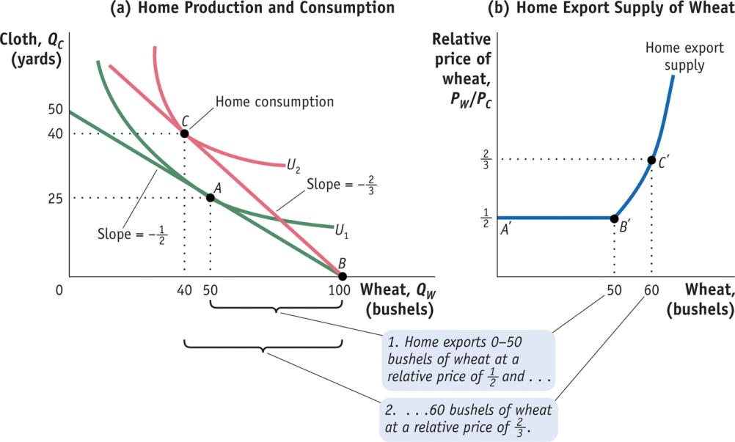
Solving for International Prices
Home Export Supply Curve
Home Export Supply (continued) For relative prices above ¹/₂, Home exports more than 50 bushels, along the segment B′ C′. For example, at the relative price of ²/₃, Home exports 60 bushels of wheat.

Slide 77
Solving for International Prices
The flat portion of the export supply curve is a special feature of the Ricardian model.
The PPF is a straight line.
Production can occur anywhere along the PPF as workers shift between industries.
This leads to all the export levels between A’ and B’.
At prices above ½, production is the same but consumption changes, rising above point A.

Slide 78
Solving for International Prices
Foreign Import Demand
We can use a similar analysis to construct the import demand for wheat in Figure E.
At the world relative price of 2/3, Foreign imports 60 bushels of wheat, C* and C*’.
The no-trade equilibrium in Foreign, with a relative price of 1, is zero imports, A* and A*’.
Production can shift from point A, at a price of 1, as workers move between industries:
If workers all shift to cloth.
Foreign imports 50 bushels of wheat, B* and B*’.
This gives us the import demand curve.

Slide 79
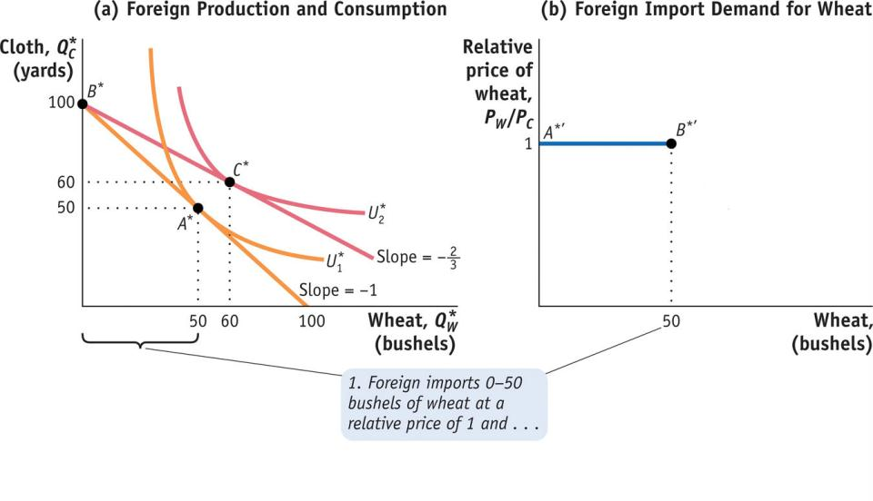
Foreign Import Demand Curve
Foreign Import Demand Panel (a) repeats Figure D, Panel (b) shows Foreign import demand for wheat. When the relative price of wheat is 1, Foreign will import any amount of wheat between 0 and 50 bushels, along the segment A*′B*′ of the Foreign import demand curve.

Slide 80
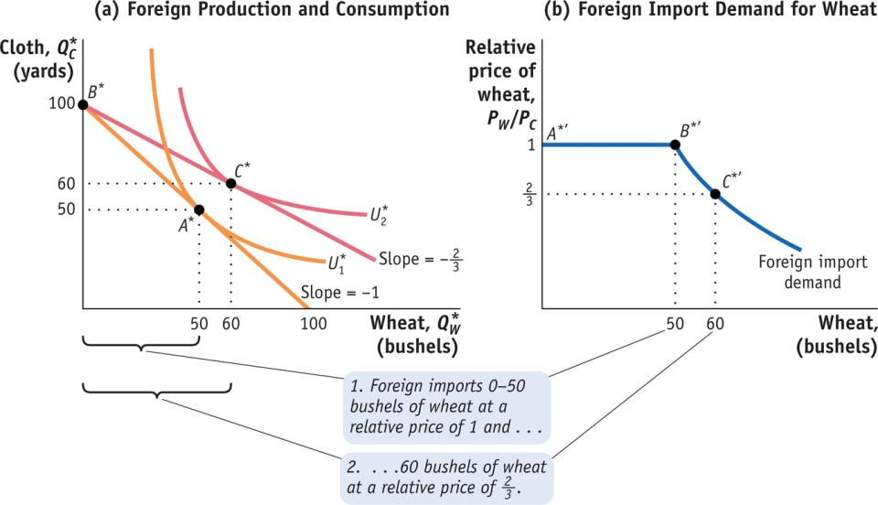
Foreign Import Demand Curve
Foreign Import Demand (continued) For relative prices below 1, Foreign imports more than 50 bushels, along the segment B*′C*′. For example, at the relative price of ²/₃, Foreign imports 60 bushels of wheat.

Slide 81
Solving for International Prices
International Trade Equilibrium
We need to put the Home export supply together with the Foreign import demand.
The exports from Home come from the excess domestic supply.
The imports to Foreign come from the excess domestic demand.
This is the World market for wheat (Figure G):
Equilibrium price of 2/3 and trade of 60 bushels of wheat.
This is the amount that clears the world market.
Desired sales of Home equal the desired purchases by Foreign.

Slide 82
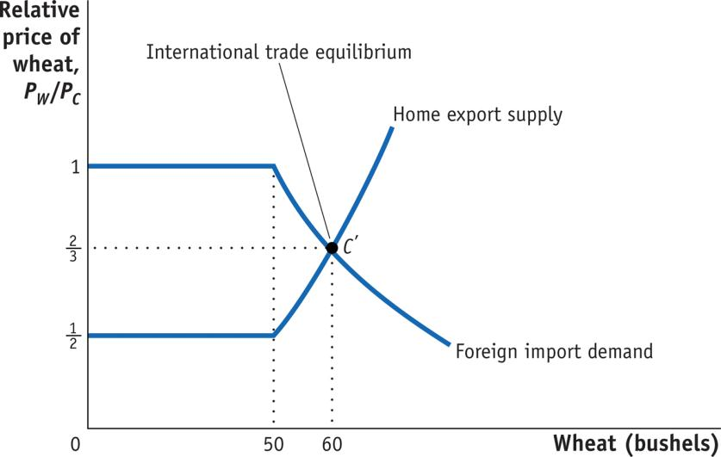
International Trade Equilibrium
World Market for Wheat Putting together the Home export supply curve and the Foreign import demand curve for wheat, the world equilibrium is established at point C′, where the relative price of wheat is ²/₃.

Slide 83
A Supply and Demand Perspective on Trade
Protectionism
The view that free trade is injurious and should be restricted
Tariff
A tax imposed on an imported good
Quota
A legal limit on the quantity of a good that may be imported

Slide 84
The Market for Computers after the Imposition of an Import Tariff
Domestic
supply
Production w/o
tariff
E
Price of computers
World price
Imports
before
tariff
Domestic
demand
q_{S}
q_{D}
Quantity of computers

Slide 85
The Market for Computers after the Imposition of an Import Tariff
Domestic
supply
Production w/o
tariff
E
Tariff tax collection
p_{T}
World price plus tariff
Price of computers
World price
Imports
after
tariff
Domestic
demand
q_{S}
q’_{S}
q’_{D}
q_{D}
Quantity of computers

Slide 86
The Market for Computers after the Imposition of an Import Quota
Domestic
supply
Price of computers
World
price
Domestic
demand
Imports with
open economy
q_{S}
q_{D}
Quantity of computers

Slide 87
The Market for Computers after the Imposition of an Import Quota
Impact of quota = impact of tariff
Revenue from quota goes to the producer
Domestic
supply
Domestic
supply
plus quota
F
p_{T}
Price of computers
World
price
Domestic
demand
Import
quota
q_{S}
q’_{S}
q’_{D}
q_{D}
Quantity of computers

