Slide 1
Economics II
Money and Banking
Money and its functions
Different money types
Modern banking
Money creation

Slide 2
kk
?

Slide 4
What is money?
It is a “symbol of success”, “a source of crime”, and it “makes the world go around”.
Money is any generally accepted means of payment for delivery of goods or settlement of debt. It is the medium of exchange.
Dog’s teeth, sea shells, gold and circular stone disks were all used as money at some point in the past. What matters is not the commodity used but the social convention that it is accepted without question as a means of payment.

Slide 7
Life in the absence of money
A barter economy has no medium of exchange. Goods are traded for other goods.
In a barter economy trading is costly because there must be a double coincidence of wants.
Both a seller and a buyer must want something that the other has to offer. People spend a lot of time and effort finding others with whom to make mutually satisfactory swaps.
Using a medium of exchange reduces the costs of matching buyers and sellers, letting society devote scarce resources to other things.

Slide 8
Other functions of money
Besides being the medium of exchange or means of payment, money (usually) has three other functions: It is (or it may be) a
store of value;
a unit of account; and
a standard of deferred payment.
However, the key feature of money is its use as a medium of exchange.

Slide 9
Money as a unit of account
The unit of account is the unit in which prices are quoted and accounts are kept.
It is usually convenient to use the same units for the medium of exchange and unit of account.
However, there are exceptions. During 2000-2001 many EU shopkeepers quoted prices both in euros and in local currency, even though the euro did not become their medium of exchange until 2002.

Slide 10
Money as a store of value
Money is a store of value because it can be used to make future purchases.
To be accepted in exchange, money has to store value. But money is not the only, nor necessarily the best, store of value.
Houses, stamp collections and interest-bearing bank accounts all serve as stores of value. Since money pays no interest and its real purchasing power is eroded by inflation, there are better ways to store value.

Slide 11
Money as a standard of deferred payment
Money is a standard of deferred payment or unit of account over time.
When you borrow from your local bank, the amount to be repaid next year is usually (but not always) measured in your local currency.
However, it is not an essential function of money. E.g. UK citizens can get bank loans specifying in dollars the amount to be repaid next year.

Slide 12
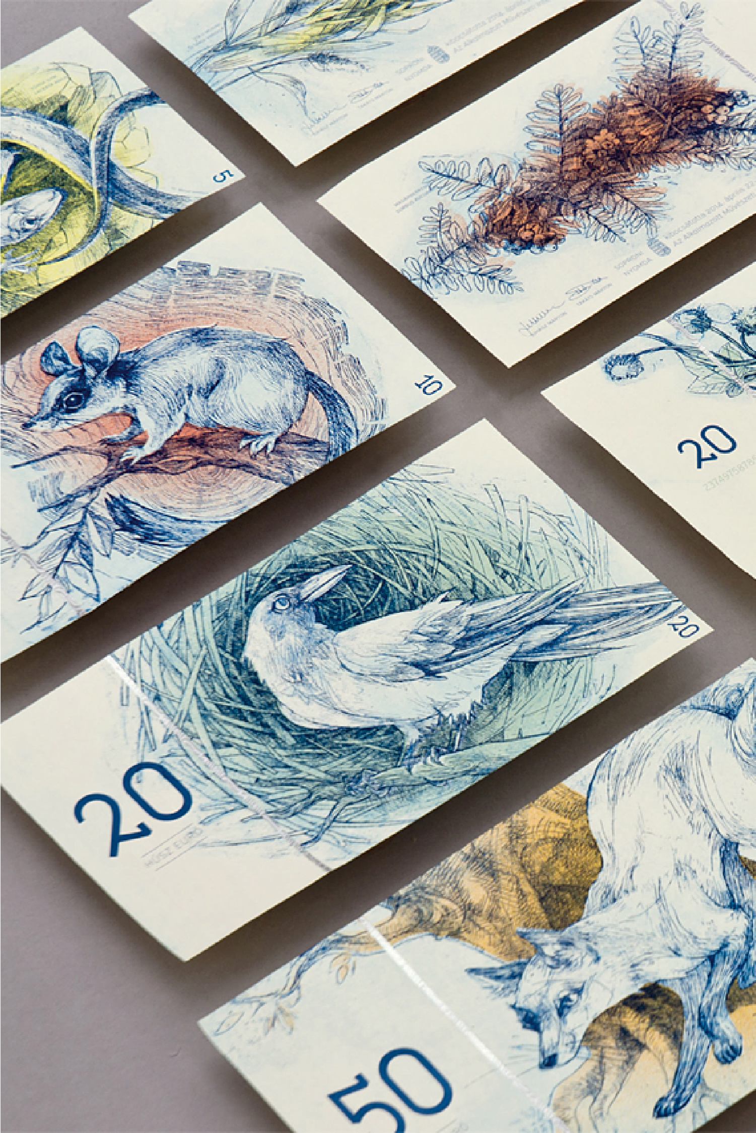

Slide 13
Different kinds of money
In POW camps, cigarettes were money. In the 19th century money was mainly gold and silver coins.
These are examples of commodity money, ordinary goods with industrial uses (gold) and consumption uses (cigarette) which also serve as a medium of exchange. To use a commodity money society must either cut back on other uses of that commodity or devote scarce resources to additional production of the commodity.

Slide 14
Token money
A token money is a means of payment whose value or purchasing power as money greatly exceeds its cost of production or value in uses other than as money. It economizes a lot on the resources needed for transacting.
Token money is accepted either because people believe it can subsequently be used to make payments or because the government makes it legal tender (by law it must be accepted as a means of payment).
The government controls the supply of token money (private production is illegal).

Slide 15
“IOU money”
In modern economies, token money is supplemented by IOU money (“I owe you”).
An IOU money is a medium of exchange based on the debt of a private firm or individual.
A bank deposit is IOU money. It is a debt of the bank. Bank deposits are a medium of exchange because they are generally accepted as payment.

Slide 16
Banks and money
Banks create money by making loans, and creating deposits that are not fully backed by cash reserves. These deposits add to the medium of exchange. The money supply is the value of the stock of the medium of exchange in circulation.
Bank reserves are the money available in the bank to meet possible withdrawals by depositors. The reserve ratio is the ratio of reserves to deposits. Deciding how many reserves to hold involves a trade-off between interest earnings and the danger of insolvency.

Slide 17
The business of banking
A bank is a business making profits by lending and borrowing. To get money in, the bank offers attractive interest rates to depositors.
Banks have to find profitable ways to lend what has been borrowed. The bank uses its specialist expertise to acquire a diversified portfolio of investments.
Most money is lent to households and firms, usually at high interest rates. Some is used to buy securities such as long-term government bonds. Some is more prudently invested in liquid assets (including cash, the most liquid asset of all).

Slide 18
Liquidity
Liquidity is the cheapness, speed and certainty with which asset values can be converted back into money.
Financial securities such as bills and bonds issued by governments and firms are often very liquid – banks can lend short term and still get their money back in time if depositors withdraw their money.
In contrast, many loans to firms and households are quite illiquid. The bank cannot easily get its money back in a hurry.

Slide 19
Differences between commercial banks and other financial intermediaries
A financial intermediary specializes in bringing lenders and borrowers together. Commercial banks are financial intermediaries licensed to make loans and issue deposits, including deposits against which cheques can be written.
Banks are not the only financial intermediaries. Insurance companies, pension funds, and building societies also take in money in order to relend it. The crucial feature of banks is that some of their liabilities are used as a means of payment, and are thus part of the money stock.

Slide 20
Sight and time deposits
Liabilities of commercial banks include sight and time deposits. The money in sight deposits can be withdrawn ‘on sight’ without prior notice. Time deposits, paying higher interest rates, require the depositor to give notice before withdrawing money.
Checking accounts are sight deposits. Time deposits, which include some savings accounts, pay higher interest rates because banks have time to organize the sale of their high-interest assets in order to have the cash available to meet withdrawals.

Slide 21
Other liabilities
Certificates of deposit (CDs) are large ‘wholesale’ time deposits, a one-off deal with a particular client for a specified period, paying more generous interest rates.
The other liabilities of banks are various ‘money market instruments’, short-term and highly liquid borrowing by banks.

Slide 22
How do banks create money?
 | Banks |  |  |  | Non-bank private sector
 | Assets |  | Liabilities |  | Monetary assets |  | Liabilities
Initial | Cash | 0 | Deposits | 0 | Cash | 1 000 | Loans from banks | 0
 | Loans | 0
Inter-mediate | Cash | 1 000 | Deposits | 1 000 | Cash | 0 | Loans from banks | 0
 |  |  |  |  | Deposits | 1 000
Final | Cash | 1 000 | Deposits | 10 000 |  | 0 | Loans from banks | 0
 | Loans | 9 000 |  |  | Deposits | 10000
Originally, there was €1000 of cash in circulation. That was the money supply. When paid into bank vaults, it went out of general circulation as the medium of exchange. But the public acquired €1000 of bank deposits against which cheques may be written. The money supply was still €1000. Then the banks created overdrafts not fully backed by cash reserves. Now the public had €10 000 of deposits against which to write cheques. The money supply rose from €1000 to €10 000. Banks created money.

Slide 23
The reserve ratio and financial panics
In our example, the reserve ratio of the banks was 10%.
The reserve ratio may be imposed by law or it can reflect profit-maximizing smart behaviour by banks that balance risk and reward.
The risk is the possibility of being short in cash, the reward is the interest rate spread. The interest rate spread is the excess of the loan interest rate over the deposit interest rate.
Everybody knows what the banks are doing. Usually people don’t mind. But if people believe that a bank has lent too much, and will be unable to meet depositors’ claims, there will be a run on the bank.
If the bank cannot repay all depositors, you try to get your money out first while the bank can still pay. Since everyone does the same thing, the bank will go bankrupt. A financial panic is a self-fulfilling prophecy.

Slide 24
Creation of token money
Cash reserves of commercial banks are a small fraction of total bank deposits. Bank-created deposit money is much the largest part of money supply in modern economies. Banks’ deposits depend on the cash reserves of the banks.
Through the central bank, the government controls the issue of token money in a modern economy. Private creation of token money is outlawed since its value as a medium of exchange exceeds the direct cost of its production.

Slide 25
The monetary base
The monetary base or stock of high-powered money is the quantity of notes and coins in private circulation plus the quantity held by the banking system.
How much of the monetary base is held by commercial banks as cash reserves? Previously we assumed that the public deposited all its cash with the banks. That was only a simplification. Everyone carries some cash around.

Slide 26
The money multiplier
How is the money supply related to the monetary base, the amount of notes and coins issued by the central bank?
The money multiplier is the ratio of the money stock to the monetary base:

Slide 27
Determinants of the multiplier
The value of the money multiplier depends on two key ratios: (1: c_{b}) the banks’ desired ratio of cash reserves to total deposits, and (2: c_{p}) the non-bank public’s desired ratio of cash in circulation to total bank deposits.
The lower the desired cash reserves ratio, the more deposits banks create against given cash reserves and the larger is the money supply.
Similarly, the lower the non-bank public’s desired ratio of cash to private sector bank accounts, the larger is the money supply for any monetary base created by the central bank.

Slide 28
The money multiplier – monetary base
Suppose banks wish to hold cash reserves R equal to some fraction c_{b} of deposits D, and that the private sector holds cash in circulation C equal to a fraction c_{p} of deposits D:
R = c_{b}D C = c_{p}D
The monetary base, or stock of high-powered money, H, is either in circulation or in bank vaults:
H = C + R = (c_{b} + c_{p})D

Slide 29
The money multiplier – money supply
Finally, the money supply is circulating currency C plus deposits D:
M = C + D = (c_{p} + 1)D
These last two equations give us the money multiplier, the ratio of M to H:
M/H = (c_{p} + 1)/(c_{p} + c_{b}) > 1

Slide 30
Money supply determination
Monetary base
Cash in circulation
Banks’ cash reserves
Money supply
The money supply comprises currency in circulation and deposits at banks. The monetary base, issued by the central bank, is held either as currency in circulation or as banks’ cash reserves. Since deposits are a multiple of banks’ cash reserves, the money multiplier exceeds 1. The monetary base is high-powered because part of it is multiplied up as the banking system created additional deposits, the major component of the money supply.

